Slide 1


Module 1: Introduction to Secrets Management
This presentation explores the critical aspects of secrets management and introduces HashiCorp Vault as a robust solution.
by Vidhya Sudarsanan

Slide 2





What is Secrets Management?
Definition
Securely storing, accessing, and controlling sensitive data such as API keys, database credentials, and passwords.
Confidentiality
Ensure secrets remain secure from unauthorized access.
Access Control
Grant access only to authorized users and services.
Auditing
Track who accessed what, when, and how.

Slide 3
Why is it Important?
Common Risks
Consequences
Credentials hardcoded in source code.
Security breaches and data loss.
Leaked secrets in logs or repositories.
Compliance violations (e.g., PCI, GDPR).
Long-lived tokens in CI/CD pipelines.
Damaged reputation and financial loss.
Lack of visibility and audit trails.

Slide 4
Traditional vs. Centralized Secrets Management
Manual approaches to secrets management are inherently risky, challenging to scale, and prone to errors. Centralized solutions offer significant advantages in security and operational efficiency.
Traditional Challenges
Centralized Benefits
Decentralized storage.
Single source of truth.
Manual rotation.
Automated lifecycle.
Limited visibility.
Comprehensive auditing.
High risk of exposure.
Reduced attack surface.

Slide 5





Where Vault Fits in the Ecosystem
Centralized Storage
Access Policies
Automated Rotation
Vault offers encrypted, centralized storage for all secrets.
Fine-grained policies ensure precise access control.
Secrets are automatically rotated to enhance security.
Broad Integration
Integrates with cloud, CI/CD, and container platforms.

Slide 6

Real-World Use Cases
App Configuration
Securely inject database and API credentials at runtime.
CI/CD Pipelines
Store build secrets and tokens within Vault.
Cloud Infrastructure
Manage dynamic IAM credentials for AWS, Azure, and GCP.
Database Access
Automate the rotation of database credentials.

Slide 7

Module 2: Getting Started with Vault
This module provides a deeper dive into HashiCorp Vault's capabilities and core concepts, guiding users through its setup and practical applications.

Slide 8

What is HashiCorp Vault?
Secure Secret Storage
Vault offers a secure, centralized system for managing secrets.
Dynamic Secrets
Generate on-demand credentials for databases and cloud IAM.
Encryption as a Service
Perform encryption operations without direct access to keys.
Audit Logging
Maintain detailed logs of all secret access and operations.

Slide 9





Core Concepts
Secrets
Vault
2
Sensitive data managed by Vault.
The central service for secret management.
1
Policies
3
Rules defining secret access permissions.
5
Secret Engines
Plugins for storing or generating secrets.
4
Auth Methods
Methods for logging into Vault.

Slide 10
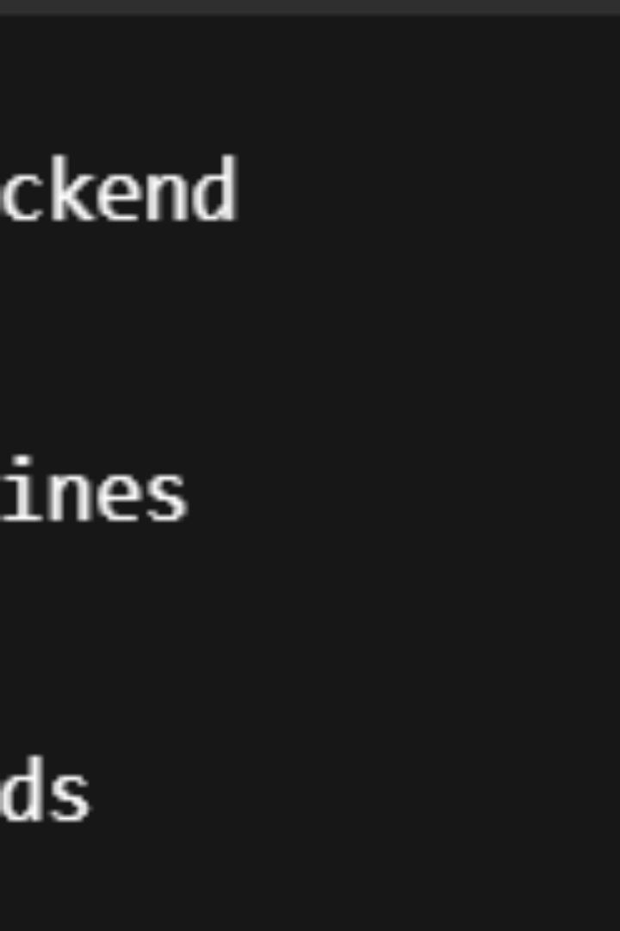
Vault Architecture
The Vault architecture includes clients, a Vault server, storage backend, and audit logs. Each component plays a crucial role in maintaining security and functionality.
1
Clients
Applications or users making requests to Vault.
2
Vault Server
Processes API requests and manages secrets.
3
Storage Backend
Stores encrypted secrets persistently.
4
Audit Logs
Records all requests for accountability.

